Slide 1
SDL Tridion Community Builder
SDL Tridion community builder
  A talk by Dominic Cronin for the Tridion community webinar

Slide 2
Introduction
Dominic Cronin
  Working with Tridion since 2001
  SDL Tridion MVP
  Principal Consultant @ Indivirtual
  www.indivirtual.com

Slide 3
Agenda
User generated content
Before you start…
Infrastructure & Architecture
Functionality
Questions and discussion

Slide 4
User generated content
What is it?
  Comments
    Spam prevention
  Ratings
    Like/Unlike content or comments
  Integrated with user identity
    TRACKING_ID
    Audience manager identity
    Other

Slide 5
Before you start
Alternative comment services
  http://www.intensedebate.com/
  http://disqus.com/

Slide 6
Before you start
Relationship with commenter
  Who owns the content?
    Do you have strategy and “legal” in place for this?
  Why are you doing this?
  Part of an “engagement” strategy?
  What is your implied “contract” with commentators?
    Can you ever alter or unpublish your own content?

Slide 7
Before you start
Do you have an interaction design?
Have you considered the infrastructure impact?
  Extra servers/databases?
  What volume of data?
  Backup strategy

Slide 8
Infrastructure
Builds on existing content delivery subsystems
  OData service
    One to accept and retrieve UGC for the web site
    One to expose UGC to the content manager and allow moderation etc.
  Ambient data framework
UGC has its own database.

Slide 9
Infrastructure in practice
A few extra jars…
… and a lot of extra configuration

Slide 10
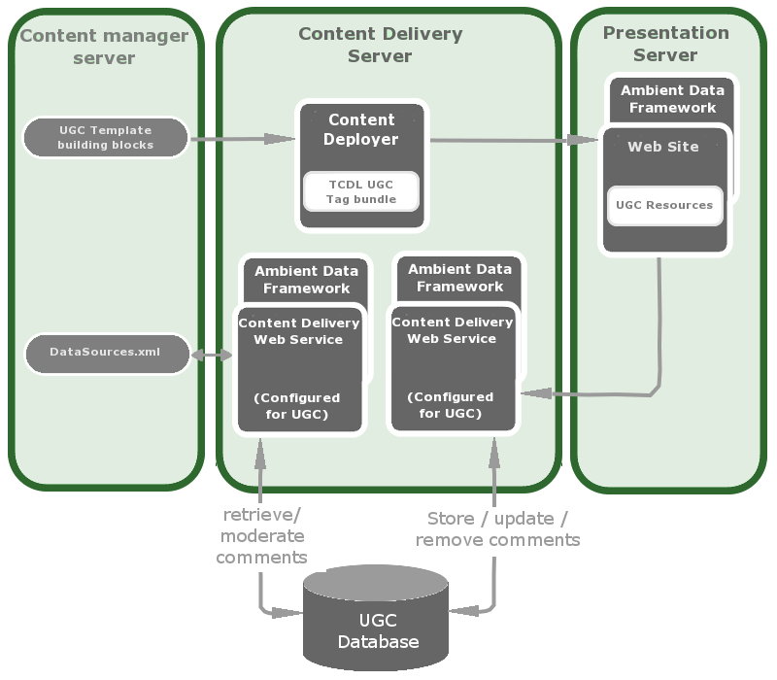
Architecture

Slide 11
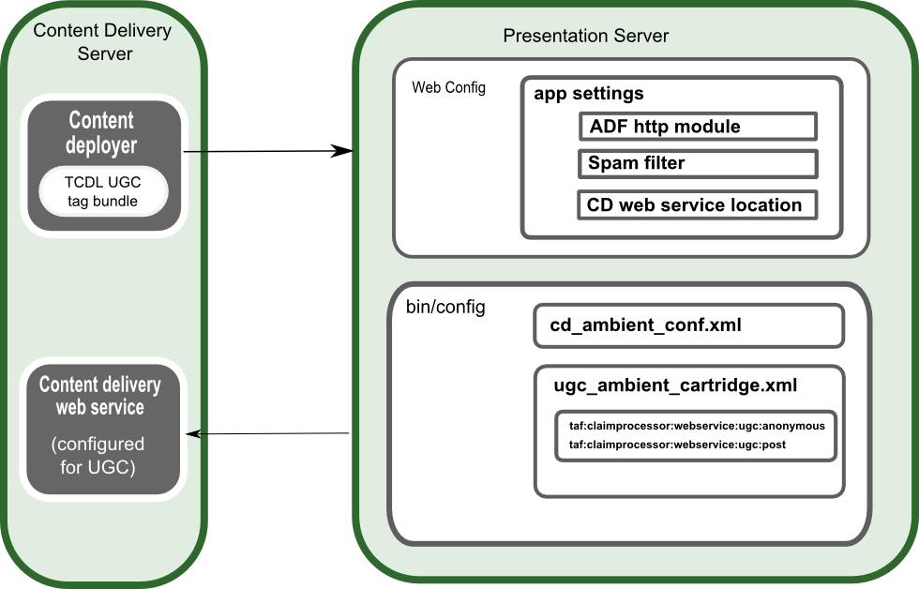
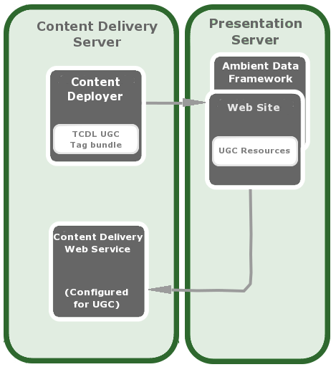
Architecture – Presentation Server

Slide 12
Architecture

Slide 13
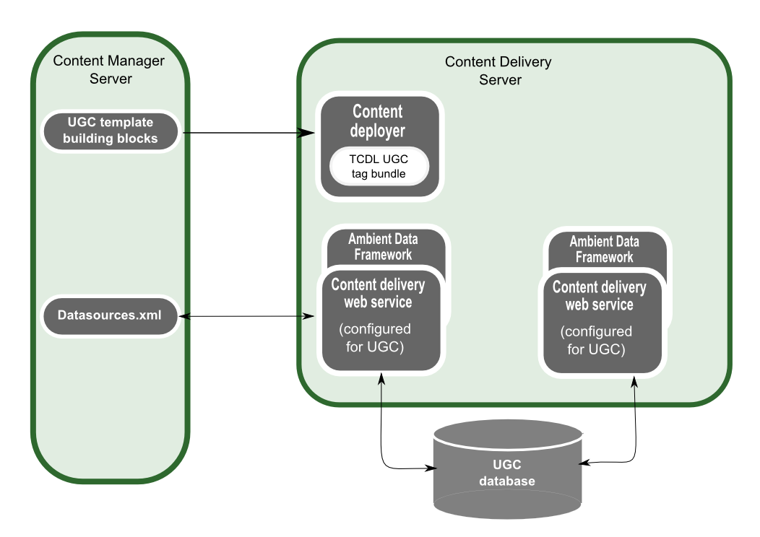
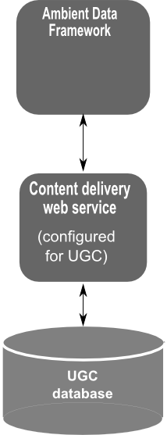
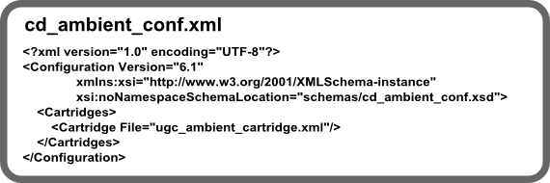
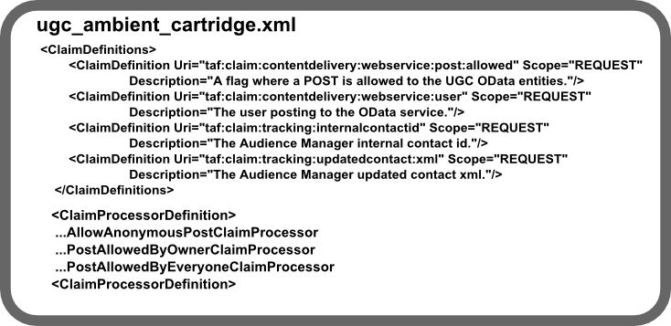
Architecture – Content delivery server

Slide 14
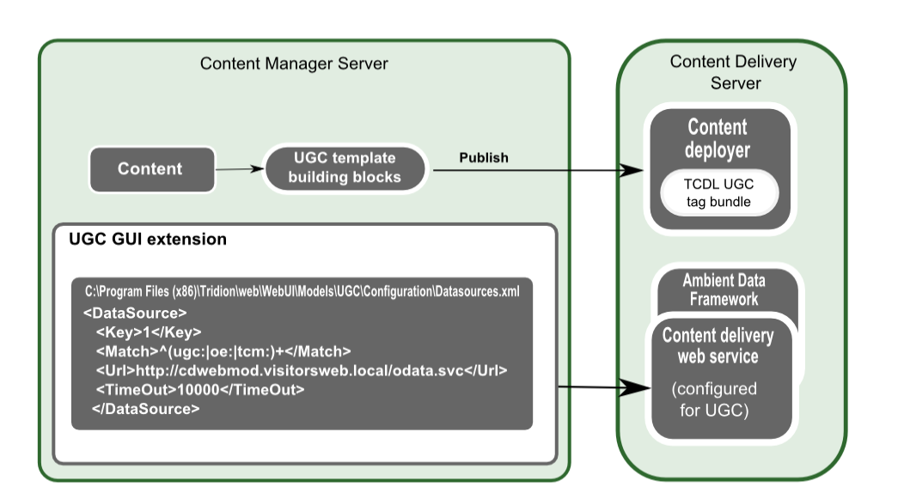
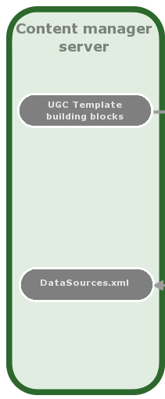
Architecture – Content manager

Slide 15
Functionality
Comments
Ratings
Users
Statistics
Spam filtering
Content filtering

Slide 16
Content manager
Add-in for the Explorer interface
  … a GUI extension
Uses Application data to specify whether to show/allow comments/ratings on a given piece of content
A TBB is provided to pull this in to your template

Slide 17
Content manager
User interface elements
  Comments and Ratings tabs in Components and Pages
  Summary lists
  Dashboard

Slide 18
Users
The UGC database can manage its own users
Also integrates with Audience manager
OAuth
Or anything else you can wire up via ADF

Slide 19
Spam filtering
Implement Spam Filter class in .NET or Java
  Configure either web.config or cd_ugc_conf.xml
If that’s all you do, the ManageComments control will just swallow your SpamFilterException.
Open question – any volunteers to write some example code for how to display a message in response to a SpamFilterException

Slide 20
Content filtering (cd_ugc_conf.xml)
<Comment>
<ScoreMinimumThreshold>-10</ScoreMinimumThreshold>
<Whitelist>
<Tag Name="a">
<Attribute Name="href">
<Protocol Name="http"/>
</Attribute>
<Attribute Name="rel" EnforcedValue="nofollow"/>
<Attribute Name="target" EnforcedValue="_blank"/>
</Tag>
<Tag Name="b"/>
<Tag Name="br"/>
<Tag Name="i"/>
<Tag Name="u"/>
</Whitelist>
</Comment>

Slide 21
Site Edit
Installing UGC will break SiteEdit
  So you have extra configuration to do to get it working again.
  But that’s covered in the installation guide

Slide 22
Practical advice
Get your services up and running first, and test them before moving on to configure CM and your web site
Be aware that the documentation will probably improve with time. For now, you need to configure more of UGC in your web site than it says.
  Probably want to use permissions to control where in the BluePrint people work.

Slide 23
Questions?
Thanks for listening
Thanks for taking part in our community

Slide 24
Links
http://www.dominic.cronin.nl
http://code.google.com/p/tridion-practice/
http://www.indivirtual.com

