Slide 1

Agile Tridion development
Tridion developer summit 2014

Slide 2





AGILE TRIDION DEVELOPMENT - Tridion Developer Summit 2014
Dominic Cronin
http://www.indivirtual.nl/blog
http://www.dominic.cronin.nl/weblog
  https://code.google.com/p/tridion-practice/
Dominic Cronin - INDIVIRTUAL | 15-05-2014

Slide 3
Agenda
AGILE TRIDION DEVELOPMENT - Tridion Developer Summit 2014
History of agile Tridion development
Where are we now?
Test Techniques
  Templating-based approaches
  Transform-based approaches
  Validation techniques
Discussion
Dominic Cronin - INDIVIRTUAL | 15-05-2014

Slide 4
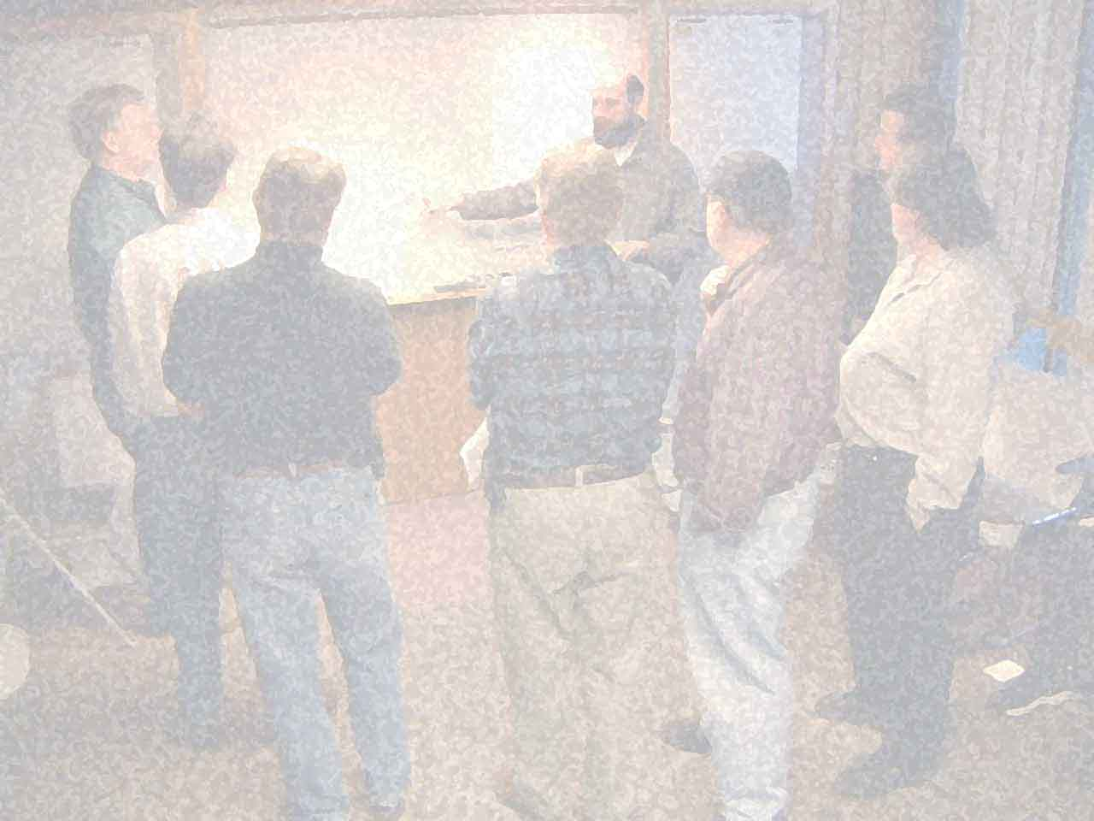
History
AGILE TRIDION DEVELOPMENT - Tridion Developer Summit 2014
2001 Agile manifesto
… gradual adoption of agile approaches in mainstream software development
2011 Agile Tridion Seminar
  hardly any adoption within Tridion community at that time
Present day
Dominic Cronin - INDIVIRTUAL | 15-05-2014

Slide 5
Present day
AGILE TRIDION DEVELOPMENT - Tridion Developer Summit 2014
  Agile
    Done it or doing it
    Thinking about it – want to do it
    Sceptical
  Flavours
    Scrum
    Kanban
    Other
Dominic Cronin - INDIVIRTUAL | 15-05-2014

Slide 6
Techniques
AGILE TRIDION DEVELOPMENT - Tridion Developer Summit 2014
Technical aspects of agile work are mostly about testing.
The test techniques fall into three main types
  Testing the template (building block)
  Testing the transform (end to end)
  Output validation
Dominic Cronin - INDIVIRTUAL | 15-05-2014

Slide 7
Templating-based testing (OO)
AGILE TRIDION DEVELOPMENT - Tridion Developer Summit 2014
Mocking the package
  Microsoft Fakes (formerly known as Moles)
    detours method calls to delegates
  Typemock
    can mock pretty much anything
… represents a fair amount of work writing the tests. Everything that Tridion does for you needs to be faked.
Dominic Cronin - INDIVIRTUAL | 15-05-2014

Slide 8
However…..
AGILE TRIDION DEVELOPMENT - Tridion Developer Summit 2014
Bjorn van Dommelen
  Automated unit testing of assembly template building blocks
  Tridion Developer Summit 2014
Dominic Cronin - INDIVIRTUAL | 15-05-2014

Slide 9

Templating-based testing (t-cubed)
AGILE TRIDION DEVELOPMENT - Tridion Developer Summit 2014
https://github.com/DominicCronin/T-cubed
Framework to give a structured way to
  modify the content of a package,
  make assertions about the content of the package.
Dominic Cronin - INDIVIRTUAL | 15-05-2014

Slide 10
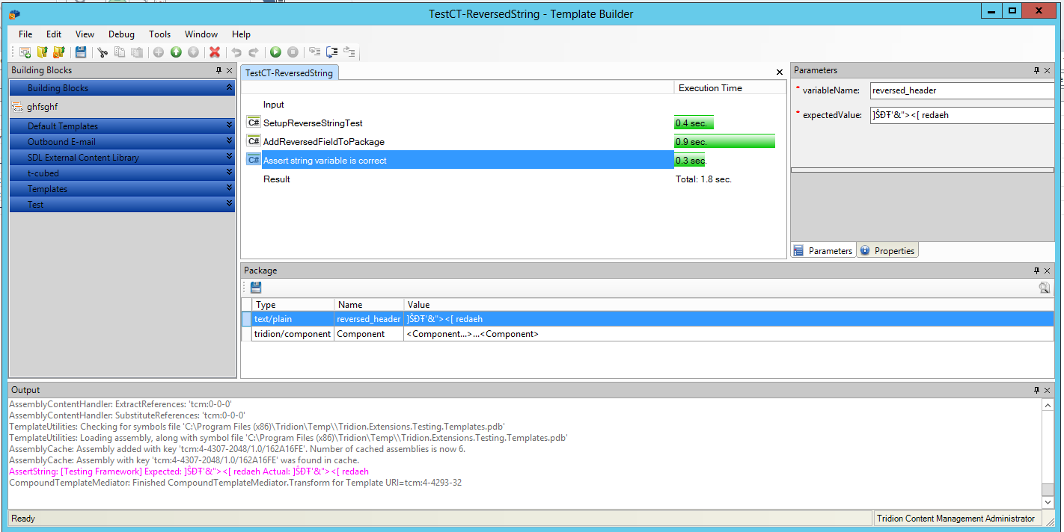
Templating-based testing (t-cubed)
AGILE TRIDION DEVELOPMENT - Tridion Developer Summit 2014
Dominic Cronin - INDIVIRTUAL | 15-05-2014

Slide 11
T-cubed demo
AGILE TRIDION DEVELOPMENT - Tridion Developer Summit 2014
Base classes in the GAC
  C:\Windows\Microsoft.NET\assembly\GAC_MSIL\Tridion.Extensions.Testing
Out-of-the-box TBBs
Dominic Cronin - INDIVIRTUAL | 15-05-2014

Slide 12

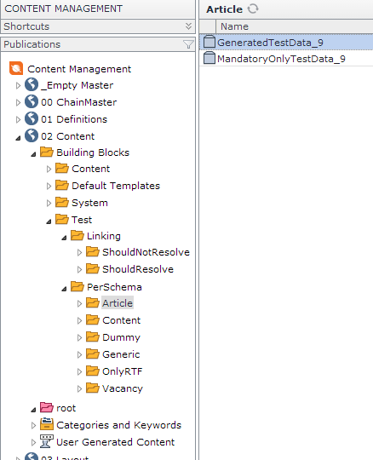
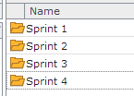
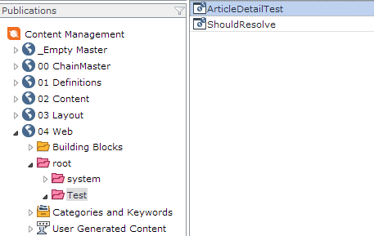

Test data
AGILE TRIDION DEVELOPMENT - Tridion Developer Summit 2014
Dominic Cronin - INDIVIRTUAL | 15-05-2014

Slide 13

Demo - Creating test data
AGILE TRIDION DEVELOPMENT - Tridion Developer Summit 2014
Dominic Cronin - INDIVIRTUAL | 15-05-2014

Slide 14

Web testing
AGILE TRIDION DEVELOPMENT - Tridion Developer Summit 2014
Various approaches, but the winner is….
Selenium … which has matured considerably over the last few years
  Selenium IDE (Firefox add-in)
  Selenium remote control
  Selenium Web Driver
  Selenium Grid
Dominic Cronin - INDIVIRTUAL | 15-05-2014

Slide 15
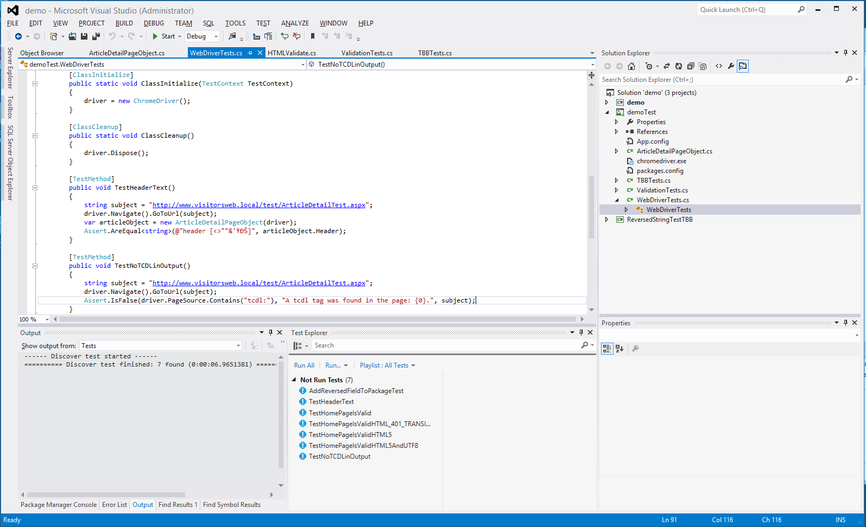
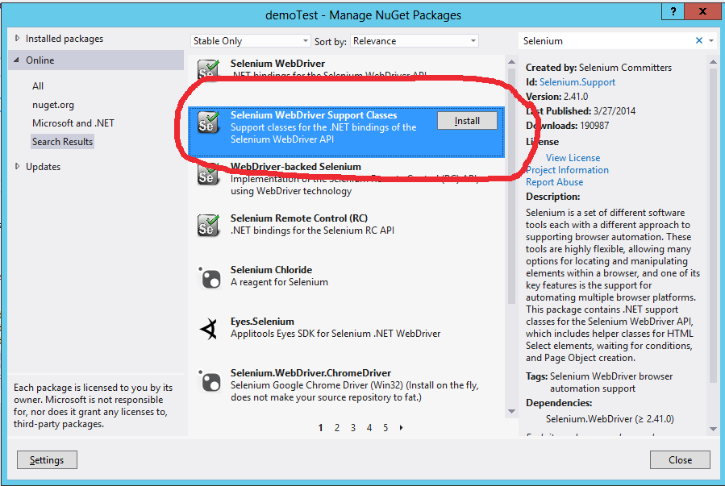
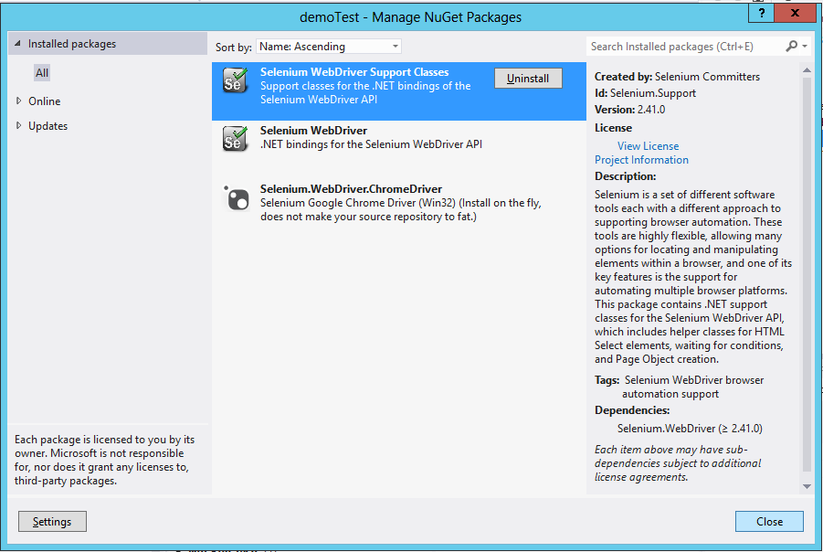
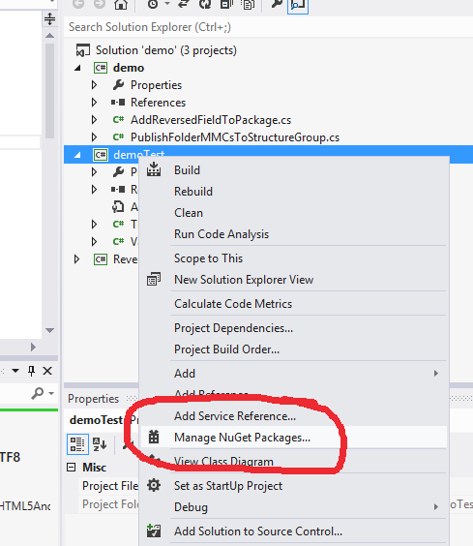
AGILE TRIDION DEVELOPMENT - Tridion Developer Summit 2014
DEMO
Dominic Cronin - INDIVIRTUAL | 15-05-2014

Slide 16

AGILE TRIDION DEVELOPMENT - Tridion Developer Summit 2014
Dominic Cronin - INDIVIRTUAL | 15-05-2014

Slide 17
Summary
AGILE TRIDION DEVELOPMENT - Tridion Developer Summit 2014
Agile development
OO testing – mocking the package
Testing TBB transforms with T-Cubed
Testing end-to-end rendering with Selenium
Automatic generation of test data
Output validation
Dominic Cronin - INDIVIRTUAL | 15-05-2014

Slide 18

AGILE TRIDION DEVELOPMENT - Tridion Developer Summit 2014
Dominic Cronin - INDIVIRTUAL | 15-05-2014

